Slide 1
HELLO THERE!
Thank you for taking the time to view my portfolio. This particular project is something I worked on in my Data Analytics class at Miami Dade College. It is an exploratory data analysis of the Inc.5000 dataset from 2014. I was required to clean the dataset in Excel, export it to Tableau for visualizations, and create a presentation based on my findings in Power Point. The Excel, Tableau, and Power Point assignments had particular guidelines that I had to follow, which I successfully accomplished, as I received a 98 out of 100 for this project. I had to physically present this project to my Professor and fellow classmates, but since this isn’t applicable in this situation, I am going to piece together my presentation with visuals from Excel and Tableau, as well as incorporate the slides from my Power Point presentation. If you have any questions or would like the actual files I created for further analysis, please, don’t hesitate to reach out as I will respond promptly with whatever information is requested of me. Thanks again and I hope you enjoy!

Slide 2

Where did we see the most growth out of the fastest-growing, privately owned American businesses in 2014?
David Perez

Slide 3
About the Inc. 5000
Inc. Magazine is an American publication that focuses on privately-owned American businesses.
Every year they list the top 5,000 fastest-growing, privately-owned American businesses.
They rank these companies according to who has the highest growth percentage, from 1-5,000.
The growth percentage is calculated based on the revenue growth percentage rate accumulated by each company over the course of a three-year time span.
The equation:
Recent Year Revenue – Base Year Revenue / Base Year Revenue X 100
Revenue is defined as the amount of revenue accumulated by the company in the year 2013.

Slide 4
Goal, Dataset, and Cleaning
Goal: To find some interesting insights about the fastest-growing, privately-held businesses in the country according to the Inc.5000, 2014 list.
Dataset: https://public.tableau.com/app/resources/sample-data.
This dataset is reflective of the data produced by the American publication, Inc. Magazine, and their annual list of the top 5,000 fastest-growing, privately-owned businesses in America.
It provides the name, location, rank, growth, revenue, workers, industry, and the total amount of years each company has been on the list.
This dataset ONLY provides data for the Inc. 5000, 2014 list.
Cleaning (Excel):
Removed redundant data.
Formatted for easier comprehension.

Slide 5
EXCEL BREAKDOWN
Deleted the “input” column as there was no data in that column.
The “_num” column, the “_resultNum” column, and the “rank” column had the exact same information. I didn’t think it was necessary to have 3 rows with the exact same information, so I deleted the “_resultNum” and “_num” columns.
The “_widgetName,” “_source”, and “_pageURL” columns didn’t have valuable data, not to mention it had the same exact value for all 5000 rows, so these columns were also deleted.
The “company” and “url” columns had the same exact information, so I deleted the “url” column.
The “state_l” column displayed the entire name of the state, while the “state_s” column displayed the state abbreviation, respectively. I didn’t think it was necessary to have both columns, so I deleted the “state_l” column and renamed the “state_s” column to “state.”
The “city” and “metro” columns were pretty similar, and I found it a little redundant and unnecessary, so I deleted the “metro” column. I felt like the “city” column was a more detailed descriptive that the overall encompassing “metro” column.
The “growth” column did not specify that the numbers in that column were precentage based. When converting the column into a percent, the numbers were still hard to read, so I tried to add a coma to the formatting, which took away the percent sign, and wasn’t a significant indication of the columns meaning. As a way to get around these issues, I formatted the numbers with a comma to make the numbers easier to read and renamed the column “growth in %” to indicate what exactly those numbers mean.
I formatted the “revenue” column as a currency.
I formatted the “workers” column with a comma and decreased the decimal places by 2 as there are no decimal places when counting an individual.
I used the MAX, MIN, MEDIAN, and AVERAGE functions to look for any outliers for the “workers,” “growth in %”, “revenue,” and “years on list” columns. There were definitely some outliers, but after further investigation and reasoning, I came to the conclusion that given the context of the dataset, these outliers seem to be justified.
I used COUNTBLANK and COUNTA to make sure all 5,000 rows had values for each column.

Slide 6
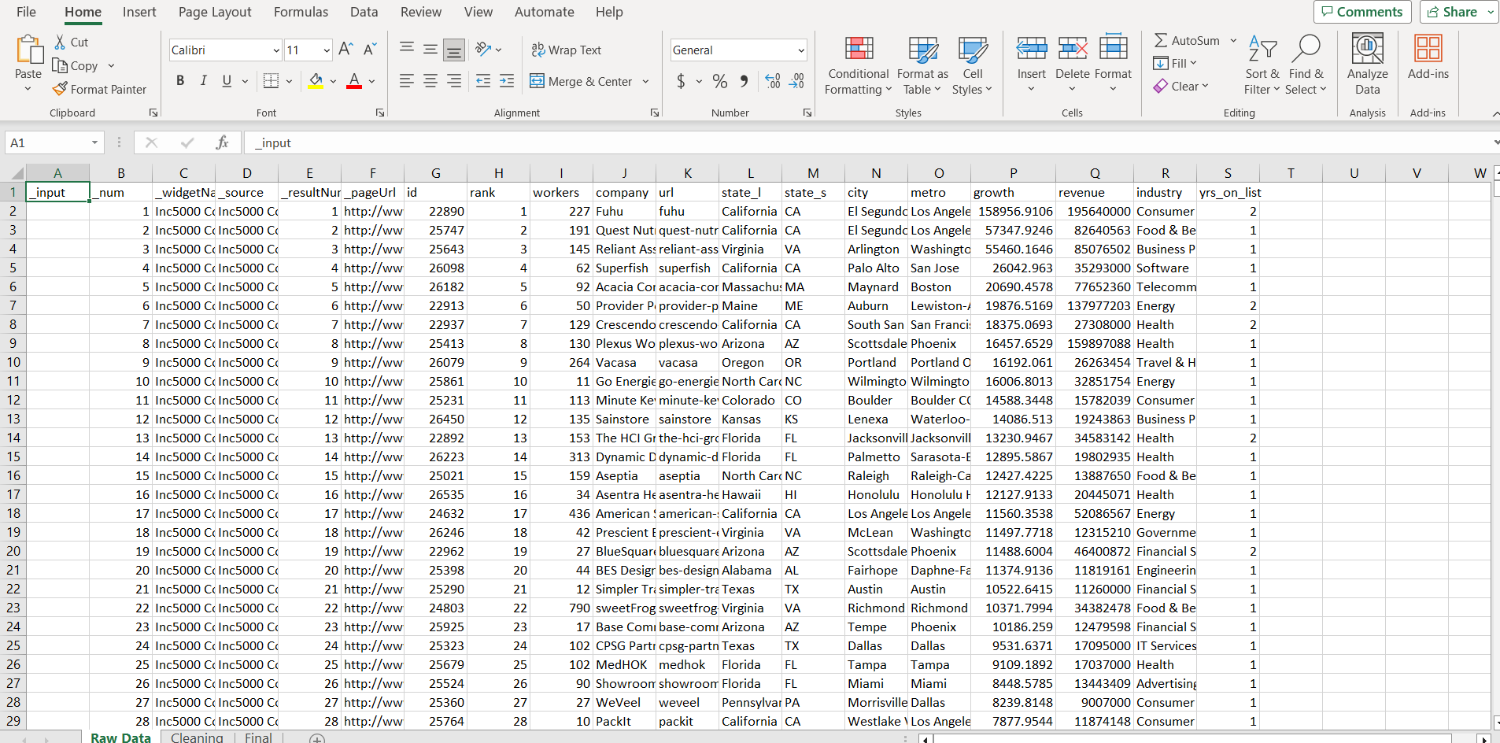
Original Dataset

Slide 7
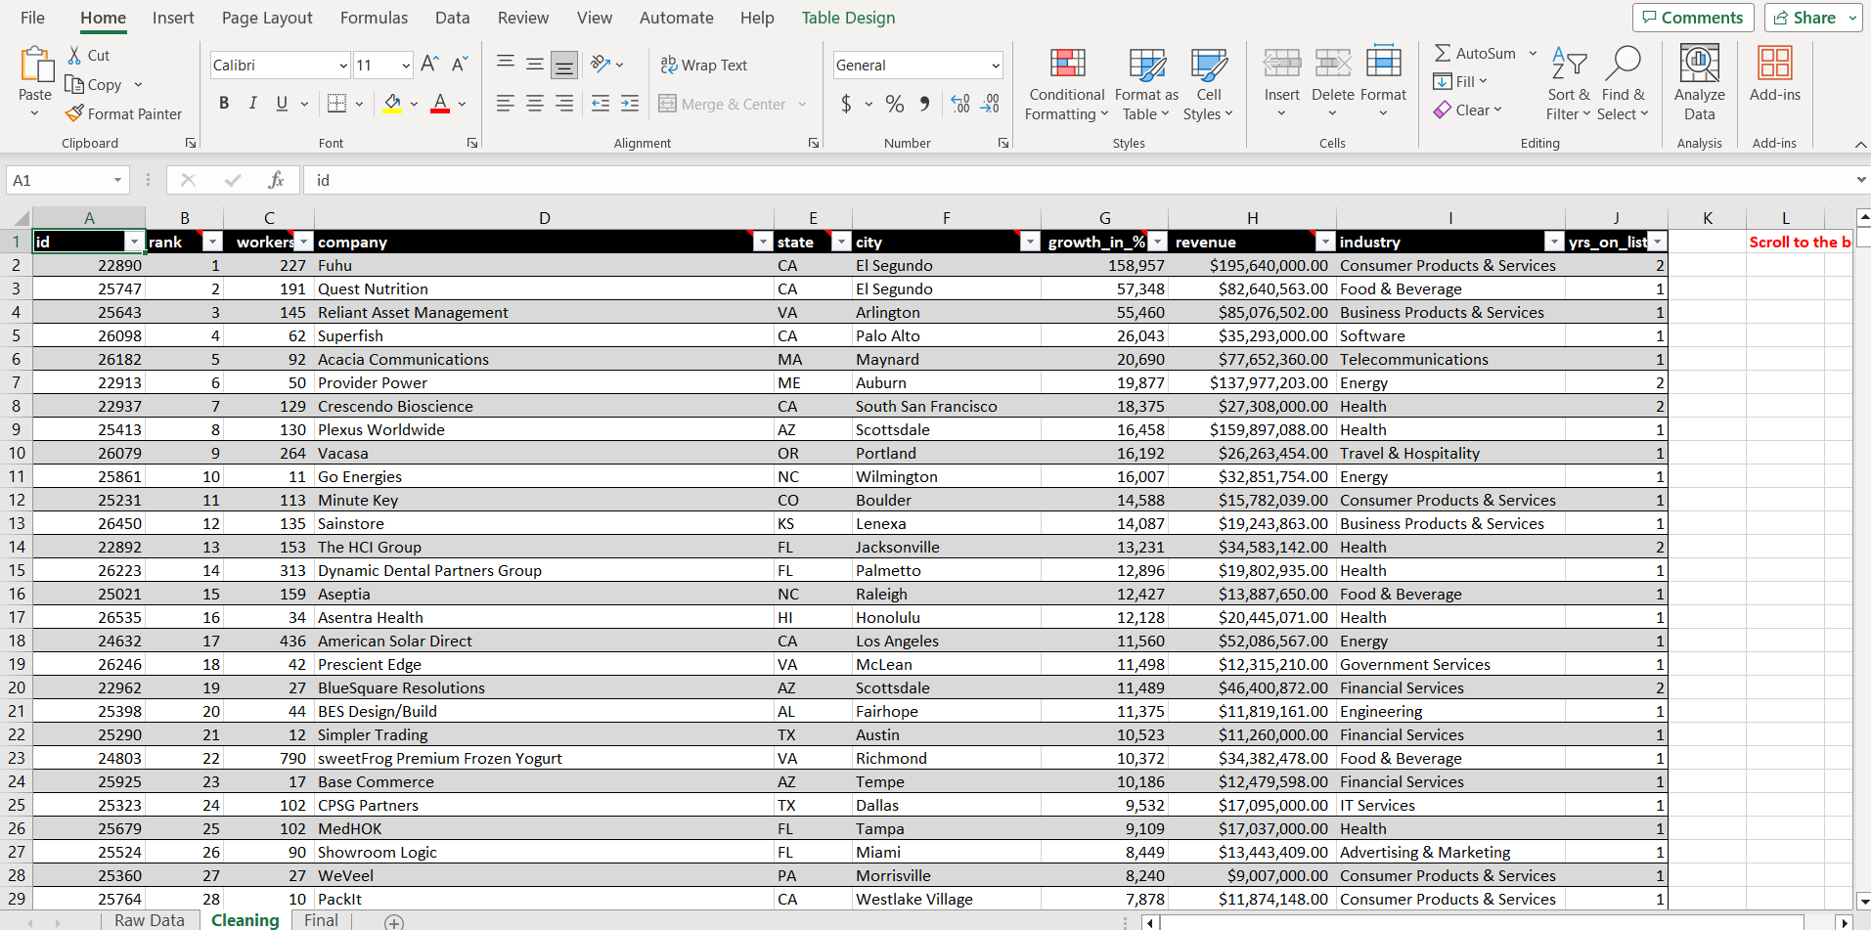
Cleaned Dataset Part 1

Slide 8
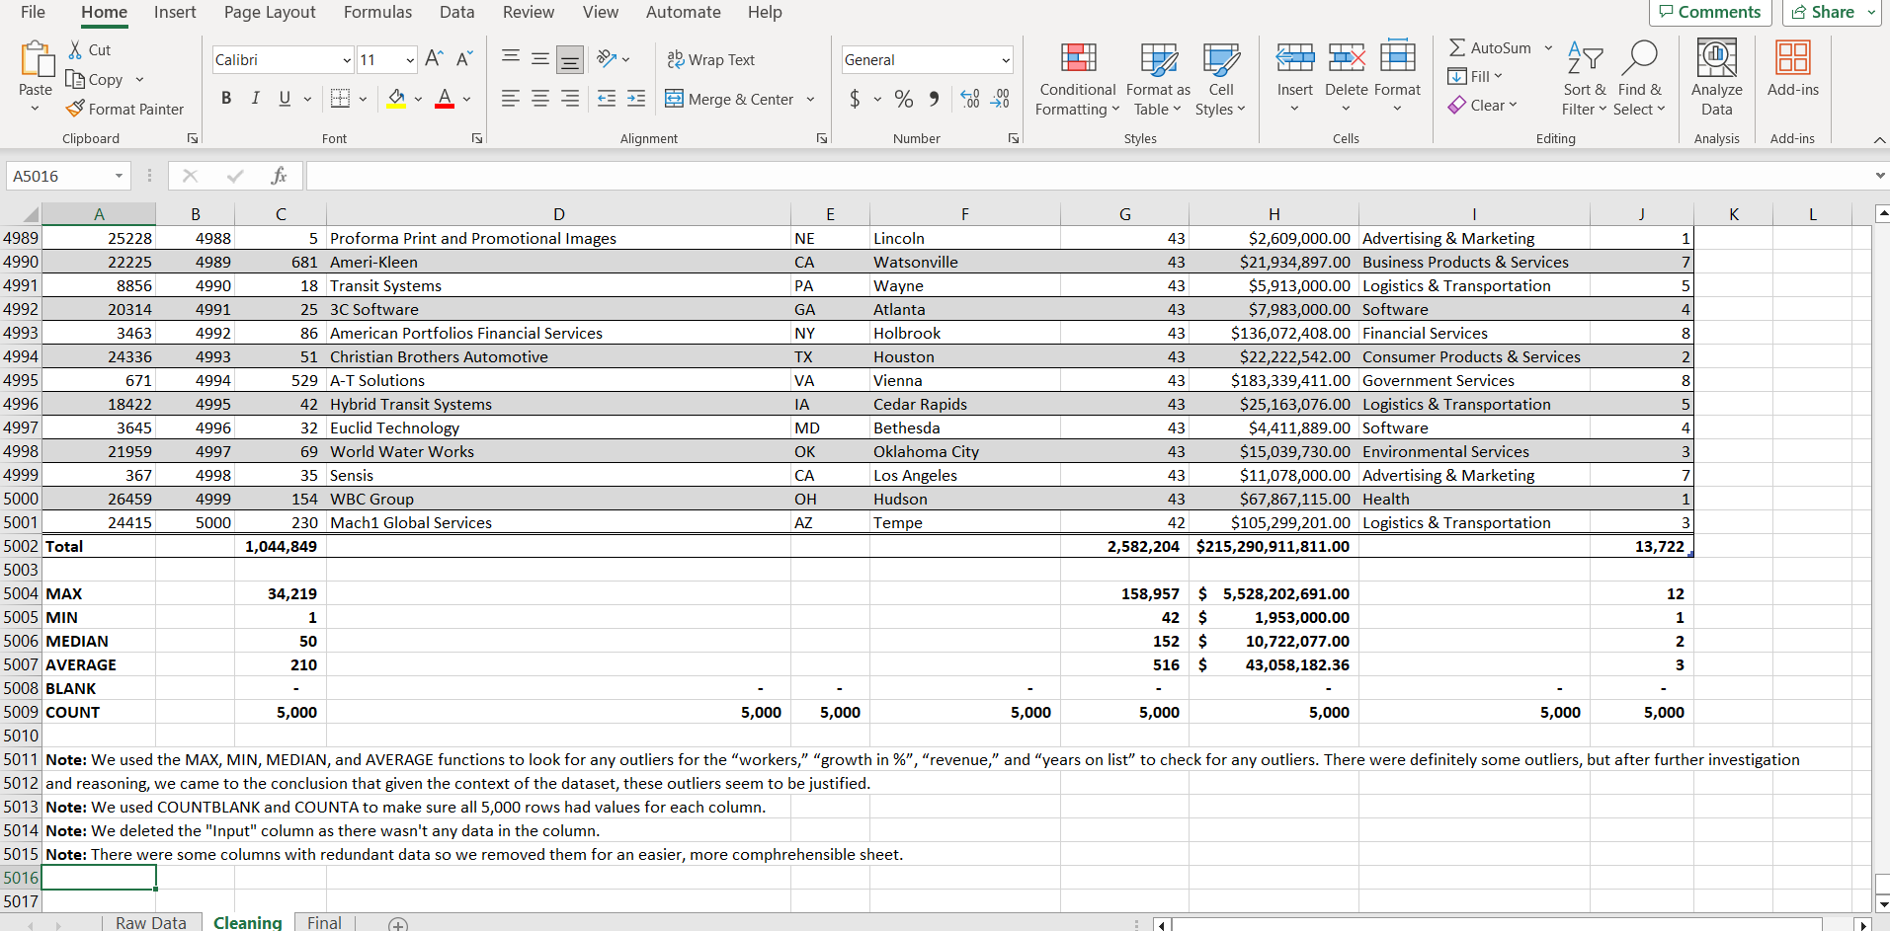
Cleaned Dataset Part 2

Slide 9
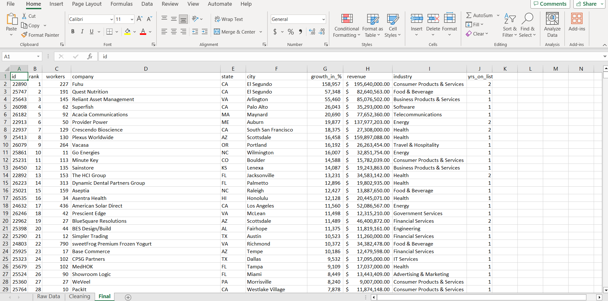
Finalized Dataset

Slide 10
TABLEAU BREAKDOWN
Although I am looking for growth in terms of growth by percentage, I am also looking for growth by revenue and workers as well. I am looking for who were the “top of their class,” so to speak, for each respective category and subcategory. I dedicated 4 graphs/maps/subcategories to each of these three main categories to attain different insights for each:
Growth/revenue/workers by company.
Growth/revenue/workers by industry.
Growth/revenue/workers by state.
Growth/revenue/workers by city.
I also felt it was important to see if there was any correlation between these categories so I created the following scatterplots based on industry:
Revenue and Workers.
Growth and Workers.
Revenue and Growth.
NOTE: I wanted to point out that I did try this based on “company” instead of “industry” at first, but I couldn’t see too much of a correlation because I felt like there were too many dots/companies to get an accurate visual assessment. Once I changed it to “industry” I did see a low positive correlation in 2 out of the 3 graphs, so I felt like this was a more visually accurate assessment.
The last sheet is a text table named “Breakdown by Industry” which organizes all of the companies according to their respective industry and gives the subtotals of each industry based on revenue and workers. I felt like this was an important table to have because you can pull detailed insights based on industry. You can also do things like compare and contrast competitors within the same industry or even compare and contrast industries as a whole.
I created three dashboards to summarize growth, revenue, and workers. Each dashboard has a map, company graph, and industry graph. Click on any one of these graphs and you will get a detailed breakdown of the other two graphs.
The last dashboard gives you a breakdown of growth, revenue, and workers by city.
NOTE: I didn’t want to use a map of the cities for this because there were too many cities close together and it would’ve been hard to click on the right one all of the time. I created a custom legend to make it easier to click on a city to access data.
NOTE: When I cleaned up the dataset in Excel, I noticed that there were two columns that represented city: “metro” and “city.” The metro column was this all-encompassing metropolitan area, that included suburbs of the city, and I felt like that was an unfair advantage when analyzing the dataset by city. I decided to keep the city column instead because I wanted a detailed insight as to what city was performing the best on their own and not because they were grandfathered into this mass metropolitan area that could be advantageous to some, while disadvantageous to others. I felt like this was a more level playing field and it did indeed give a couple of interesting insights.

Slide 11
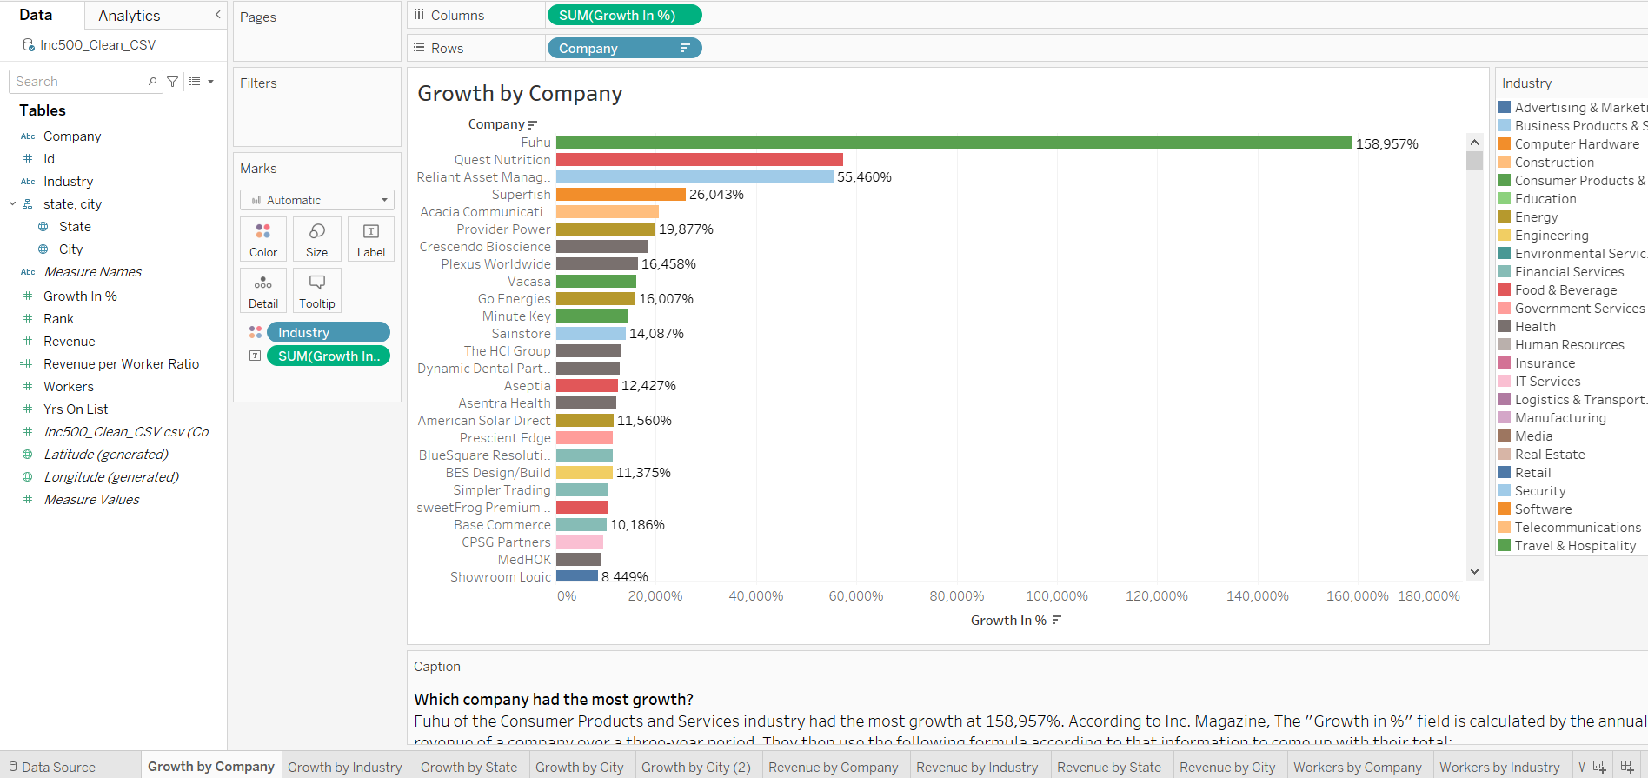
Tableau “Growth by Company” Horizontal Bar Chart Visual

Slide 12
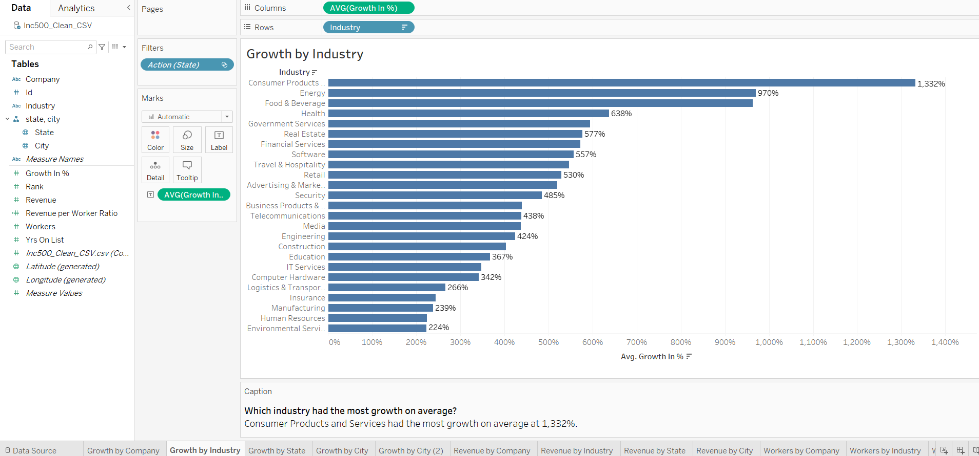
Tableau “Growth by Industry” Horizontal Bar Chart Visual

Slide 13
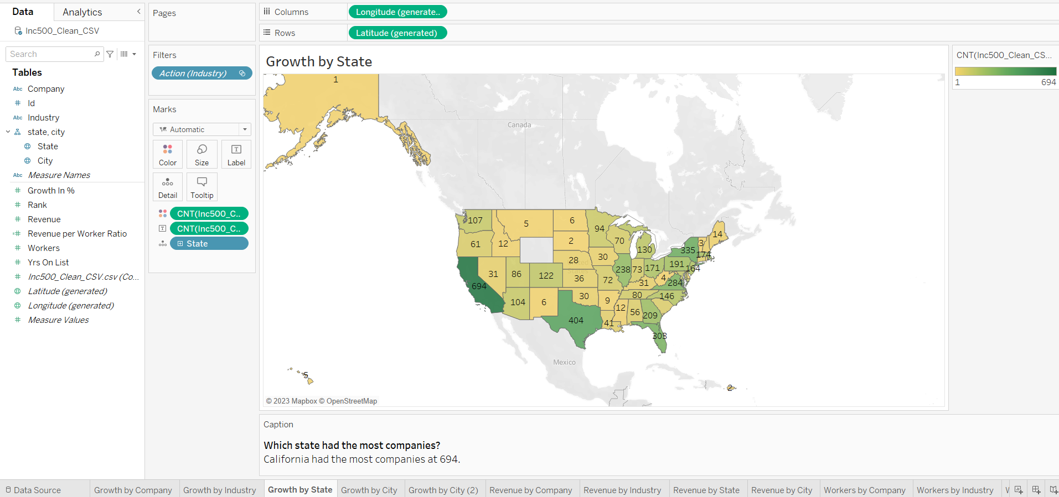
Tableau “Growth by State” Filled Map Visual

Slide 14
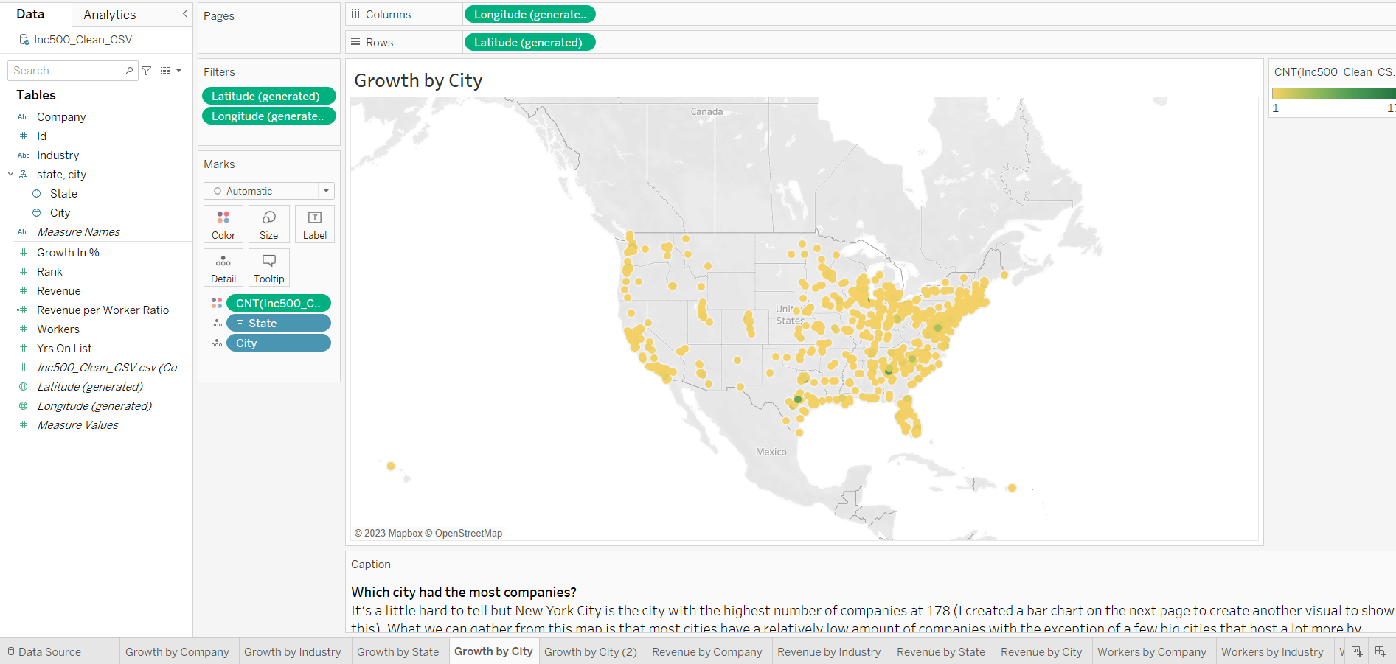
Tableau “Growth by City” Symbol Map Visual

Slide 15
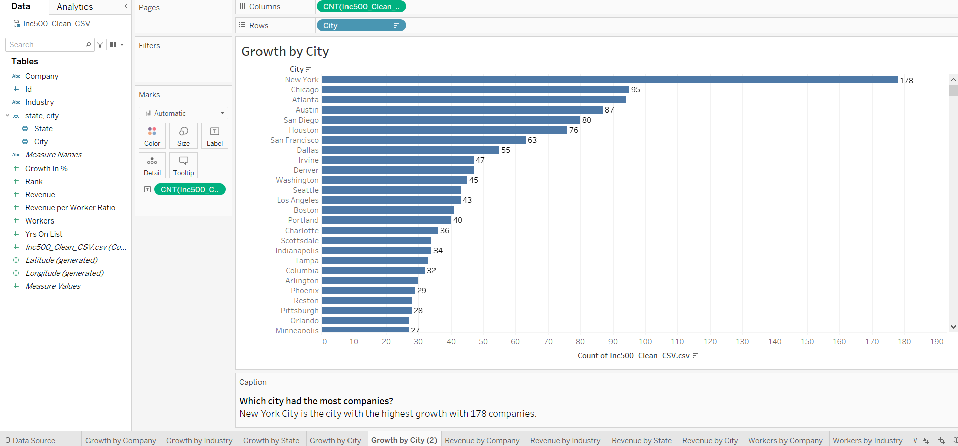
Tableau “Growth by City (2)” Horizontal Bar Chart Visual

Slide 16
Analysis and Findings
(Growth)
Fuhu, a computer and electronics manufacturing company, had the most growth in 2014 at a growth rate of 158,857%.
Consumer Products and Services was the industry with the highest growth percentage on average 1,332%.
California was the state with the most companies at 694.
Most cities have a relatively low amount of companies with the exception of a few big cities that host a lot more by comparison.
New York City was the city with the most companies at 178.

Slide 17
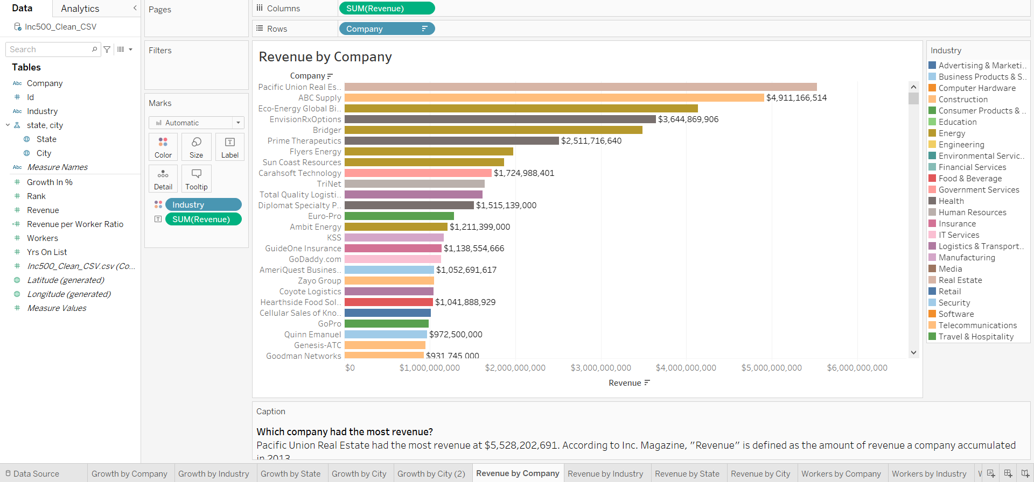
Tableau “Revenue by Company” Horizontal Bar Chart Visual

Slide 18
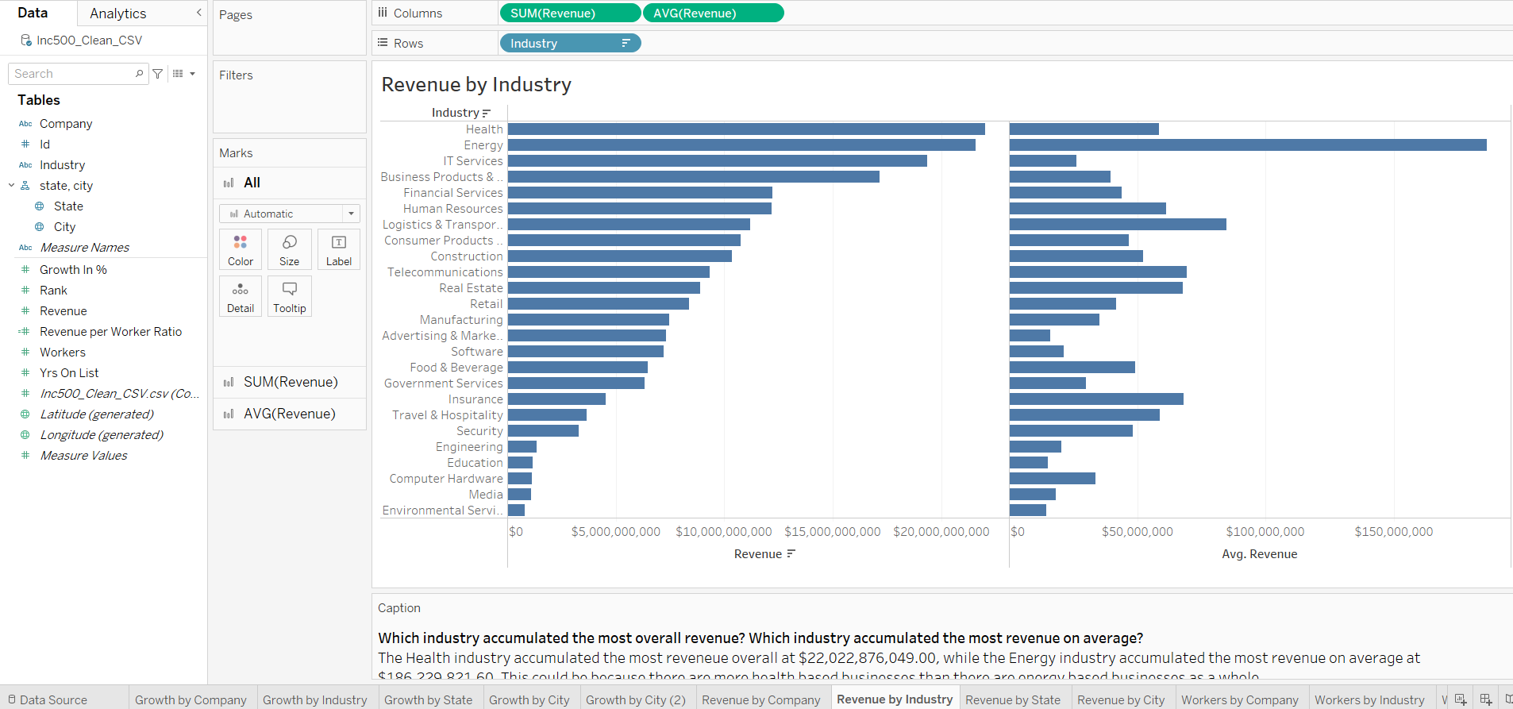
Tableau “Revenue by Industry” Horizontal Bar Chart Comparison Visual

Slide 19
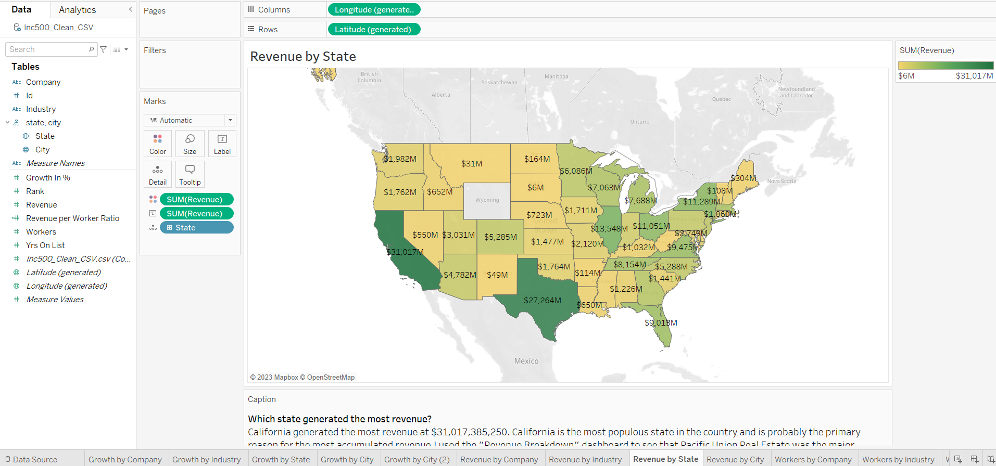
Tableau “Revenue by State” Filled Map Visual

Slide 20
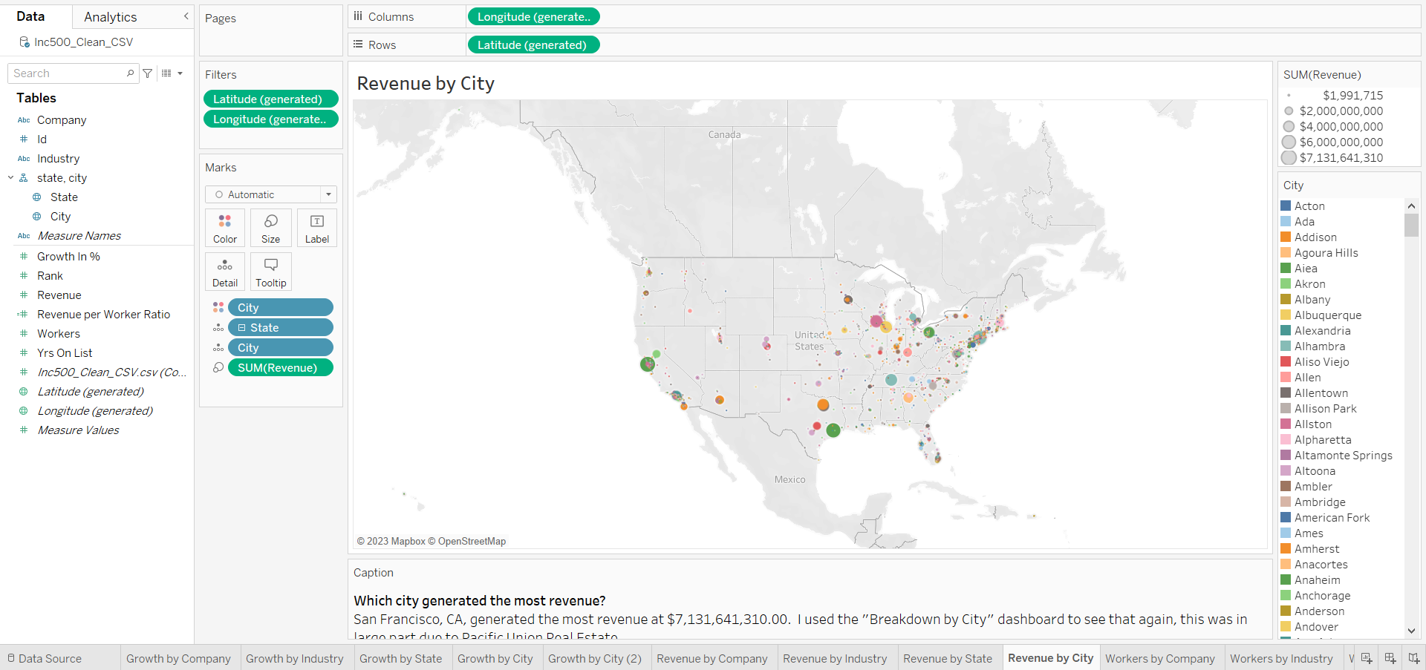
Tableau “Revenue by City” Symbol Map Visual

Slide 21
Analysis and Findings
(Revenue)
Pacific Union Real Estate was the company that accumulated the most revenue as of 2014 at $5,528,202,691.
Health was the industry to accumulate the most revenue as of 2014 at $22,022,876,049, while the Energy industry accumulated the most revenue on average at $186,229,821.
California was the state that generated the most revenue at $31,017,385,250.
San Francisco, CA, was the city that generated the most revenue at $7,131,641,310, nearly a quarter of the entire state of California’s accumulated revenue.

Slide 22
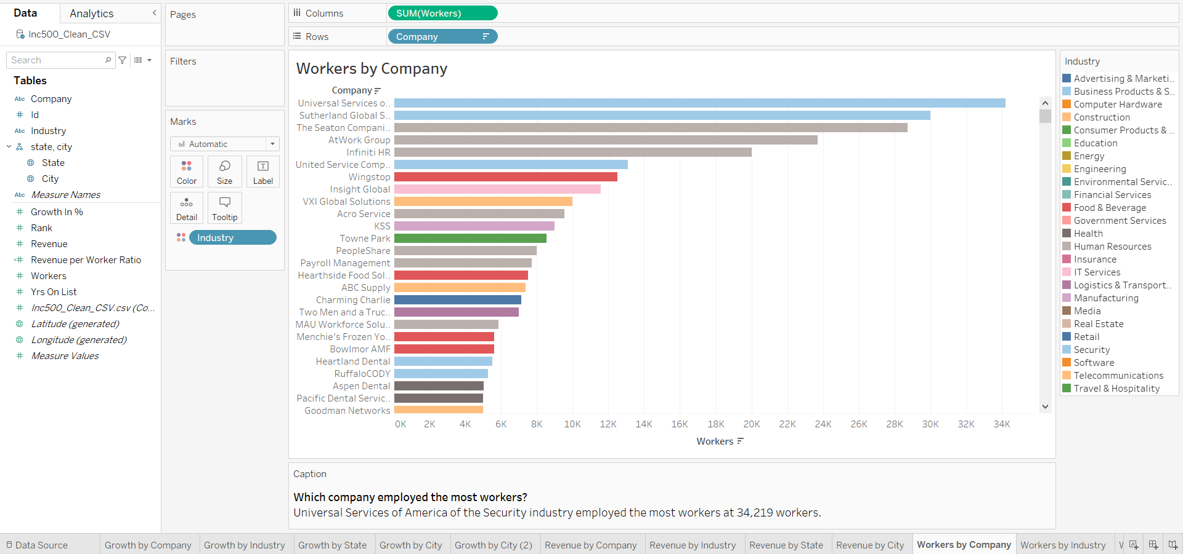
Tableau “Workers by Company” Horizontal Bar Chart Visual

Slide 23
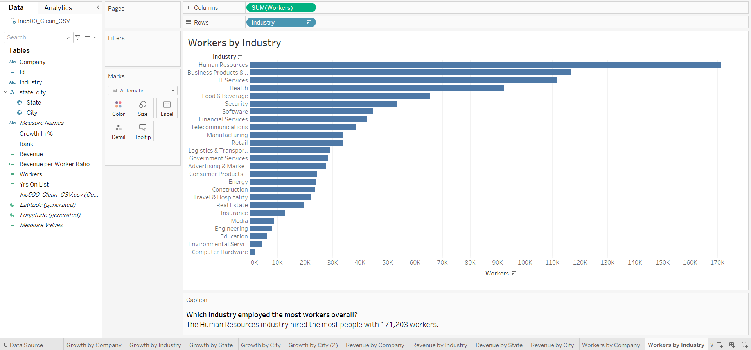
Tableau “Workers by Industry” Horizontal Bar Chart Visual

Slide 24
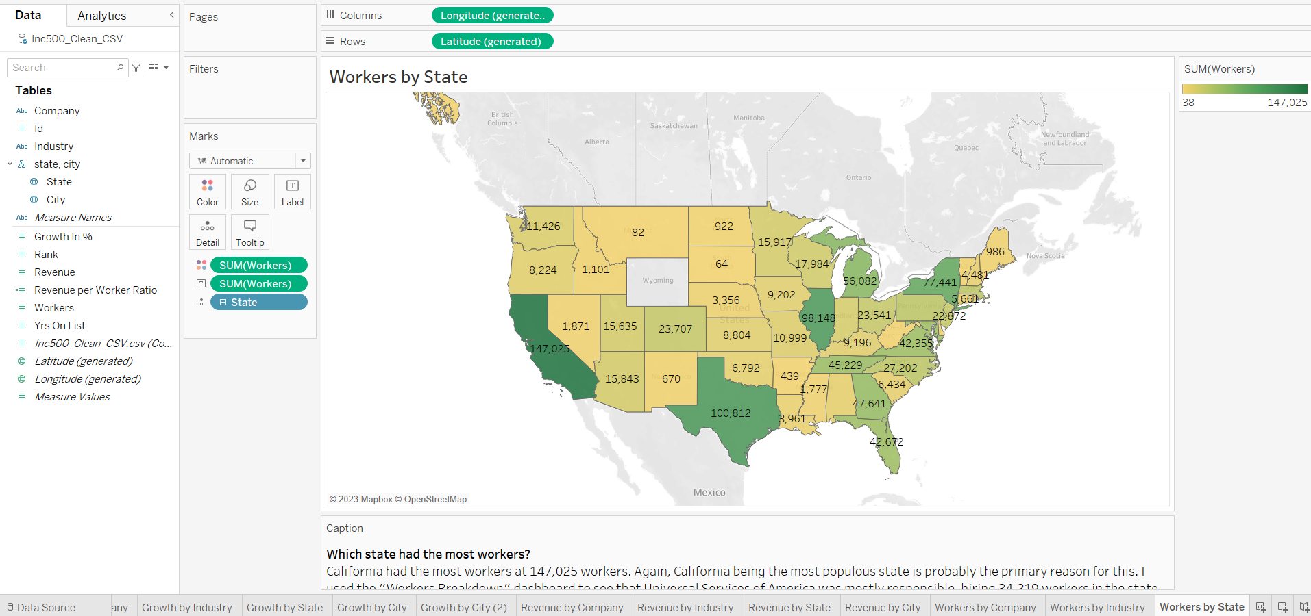
Tableau “Workers by State” Filled Map Visual

Slide 25
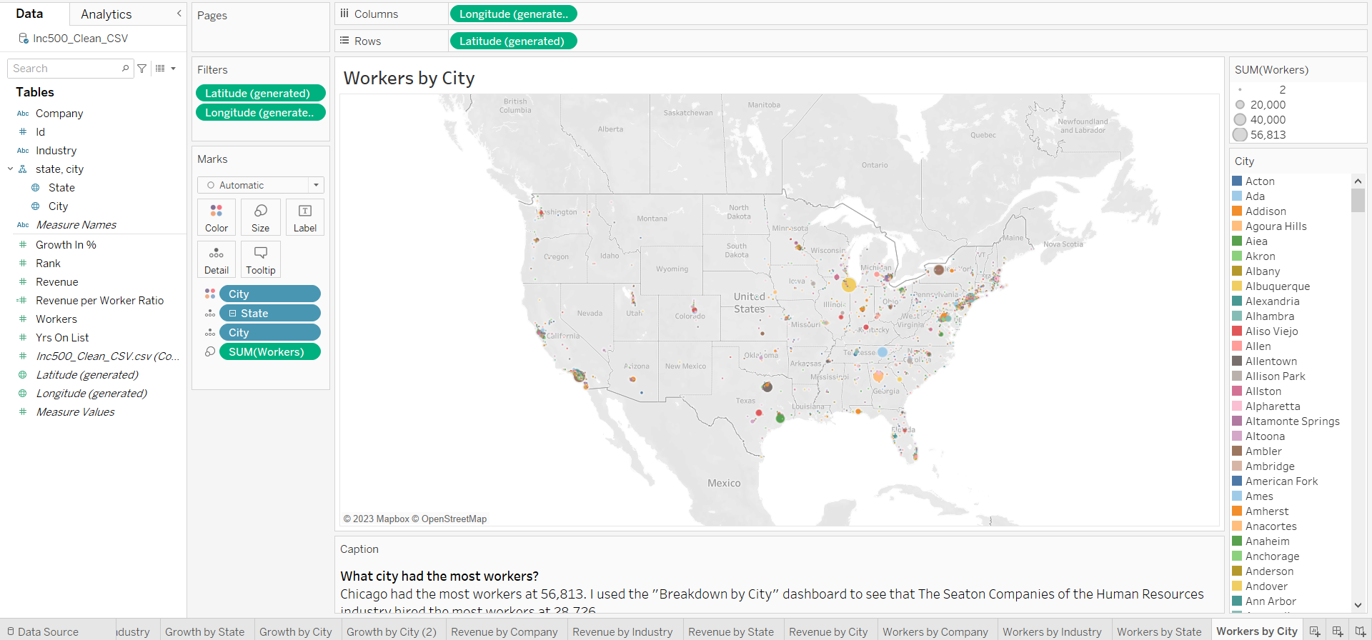
Tableau “Workers by City” Symbol Map Visual

Slide 26
Analysis and Findings
(Workers)
Universal Services of America, of the Security Industry, employed the most workers at 34,219 workers.
The Human Resources industry hired the most people overall at 171,203 workers.
California was the state that hired the most people at 147,025 workers.
Chicago, IL was the city that hired the most people at 56,813 workers.

Slide 27
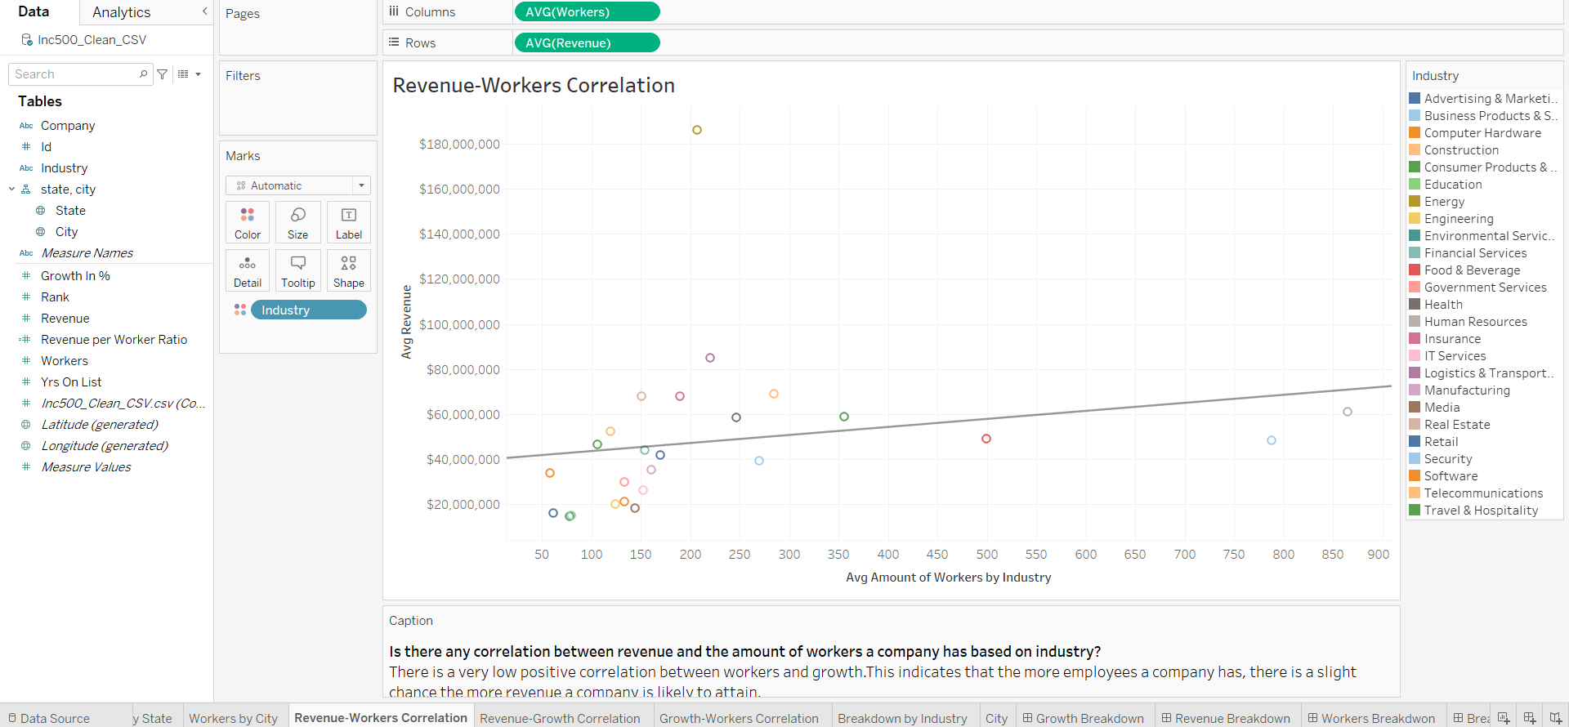
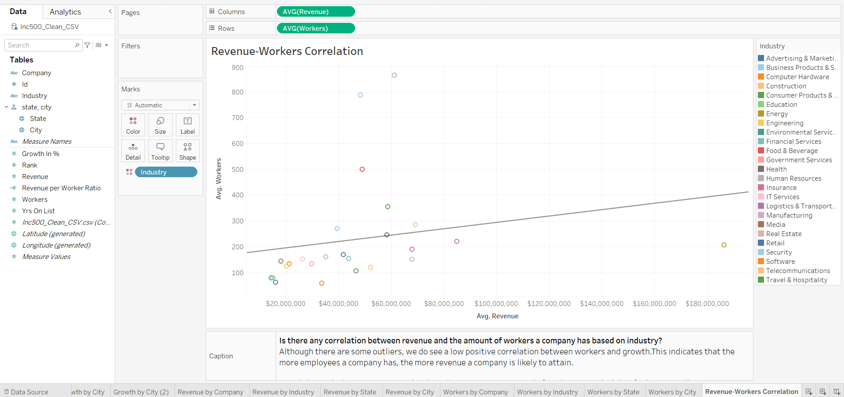
Tableau “Revenue-Workers Correlation” Scatterplot Visual

Slide 28
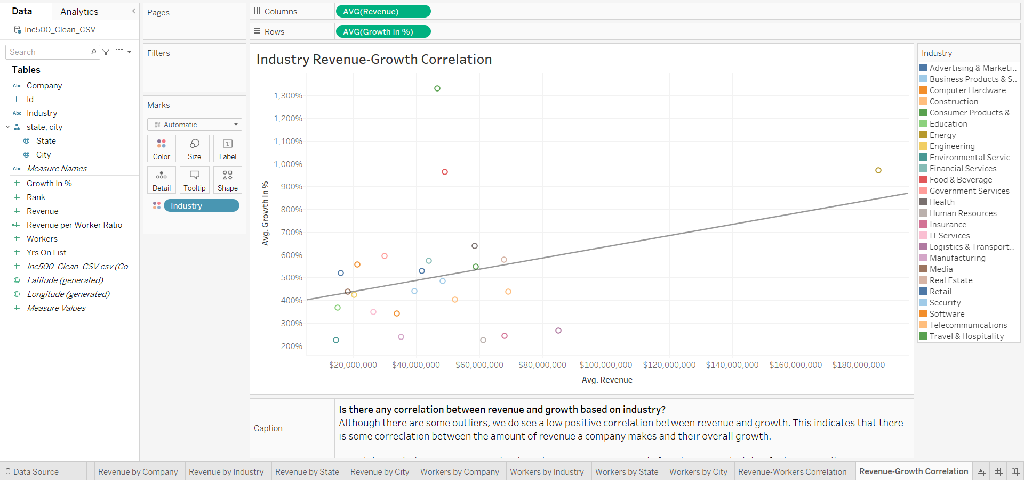

Tableau “Revenue-Growth Correlation” Scatterplot Visual

Slide 29
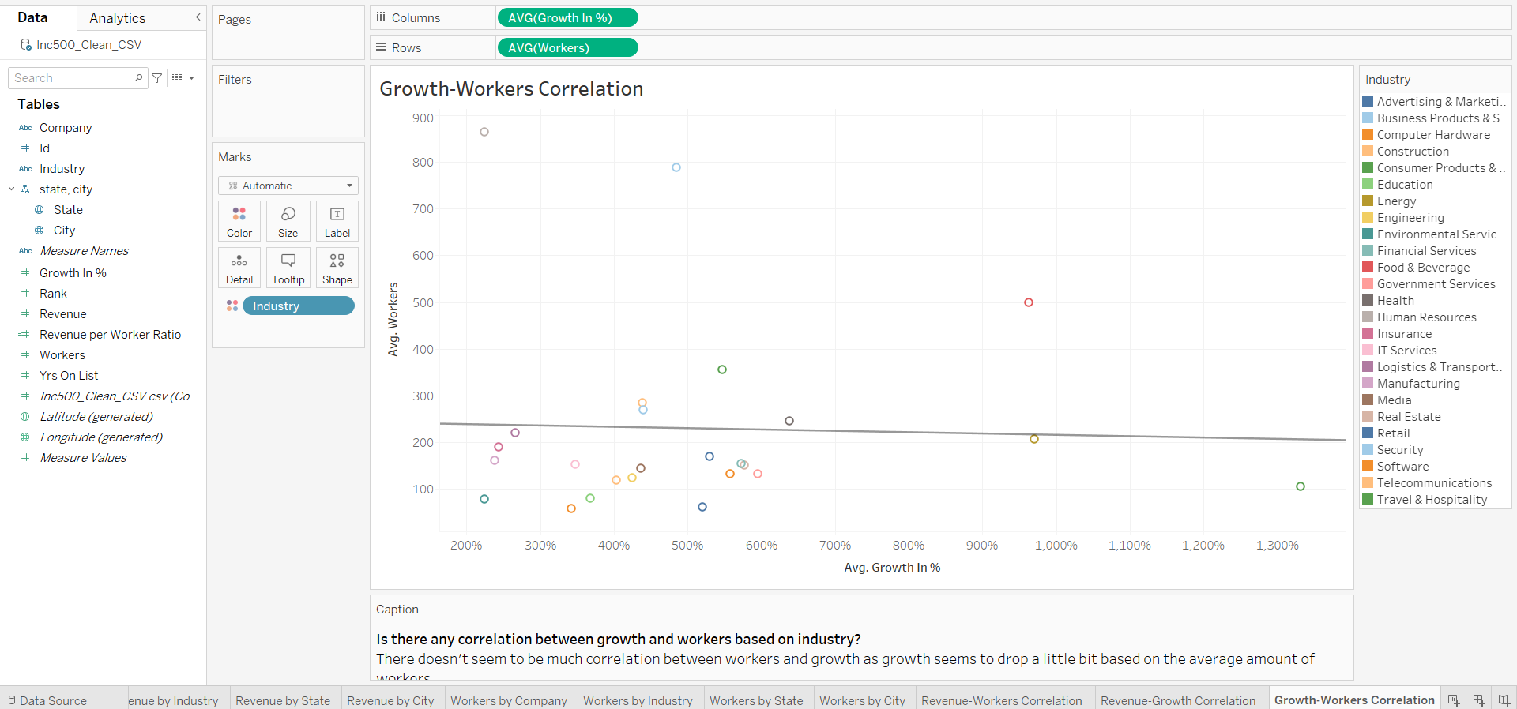
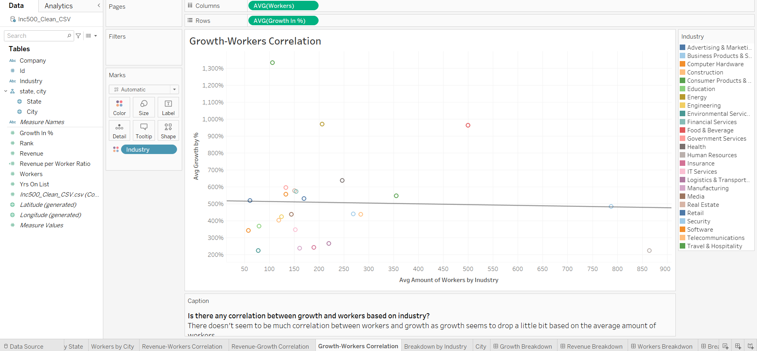
Tableau “Growth-Workers Correlation” Scatterplot Visual

Slide 30
Analysis and Findings
(Correlation)
Although there were some outliers, I did see some very low positive correlations between the following based on Industry:
The amount of revenue accumulated and the total amount of workers that were employed.
The amount of revenue accumulated on average and the average amount of growth.
There was little to no correlation between workers and growth.

Slide 31
Conclusion
Even though I felt like some of these findings were a bit obvious, like California generating the most revenue, for example (as it is the most populous state in the country), I was pleasantly surprised by other findings.
Interesting Findings:
San Francisco, CA, was the city that generated the most revenue.
Human Resources was the industry that hired the most people.
Chicago, IL was the city that hired the most people.
Wyoming didn’t have any of the fastest-growing, privately-owned companies out of the Inc.5000!
There weren’t any significant correlations between revenue and workers, revenue and growth, or workers and growth.

Slide 32
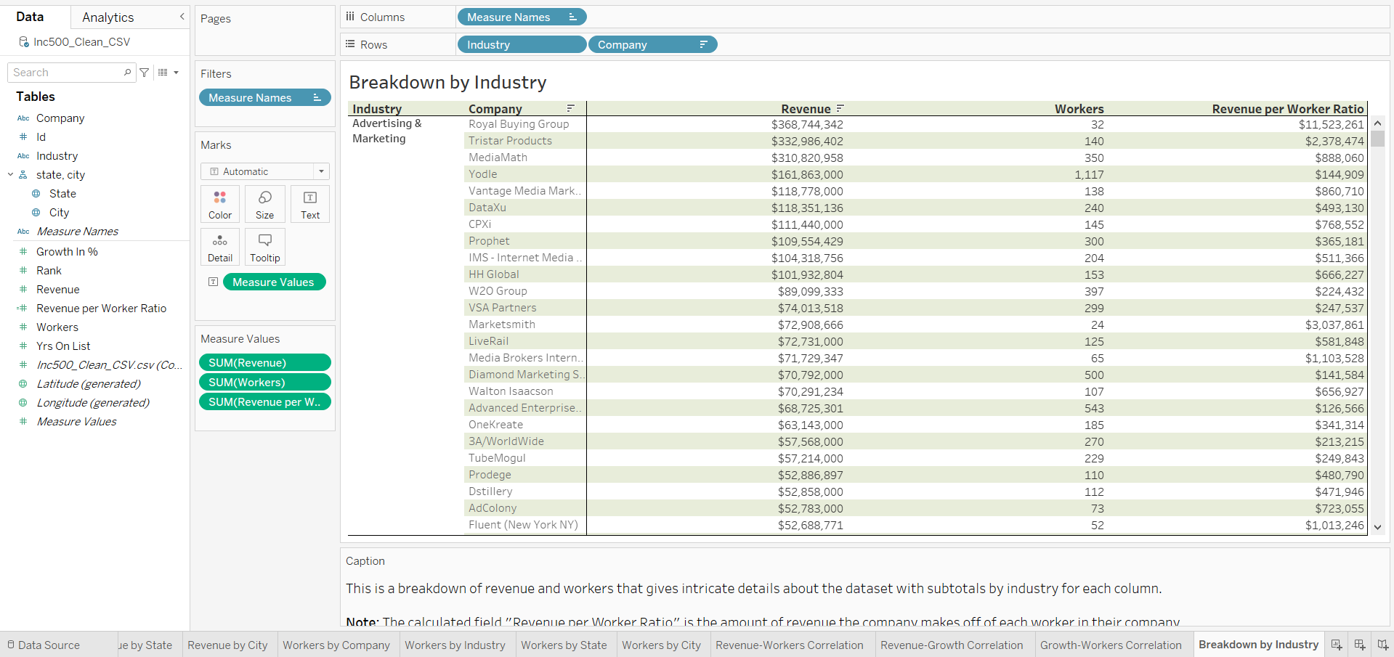
Tableau “Breakdown by Industry” Text Table Visual (as a reference tool)

Slide 33
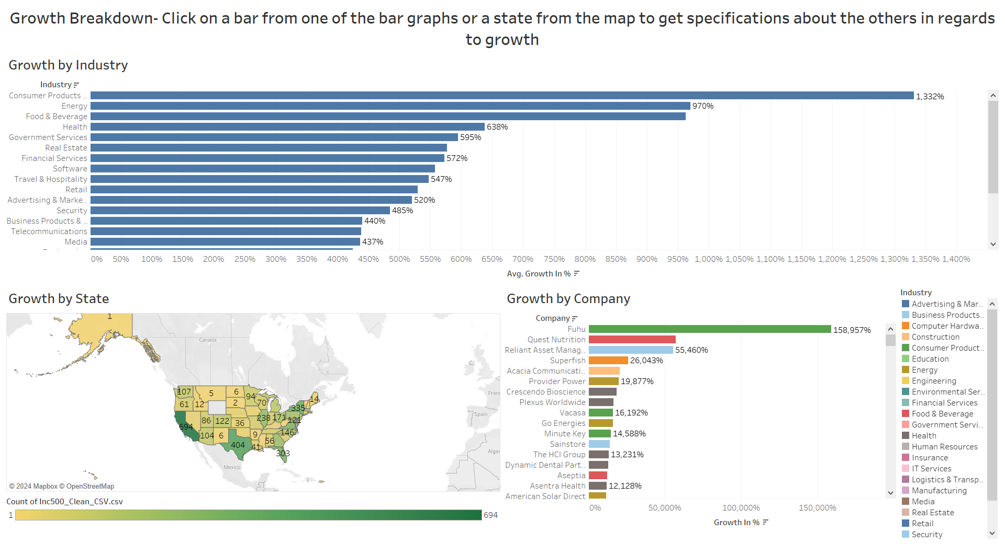
Tableau “Growth Breakdown” Dashboard Visual

Slide 34
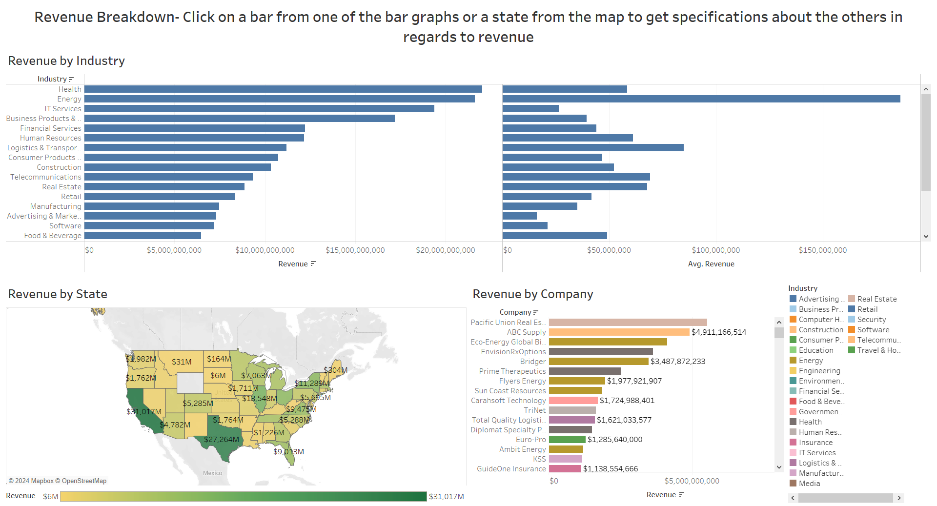
Tableau “Revenue Breakdown” Dashboard Visual

Slide 35
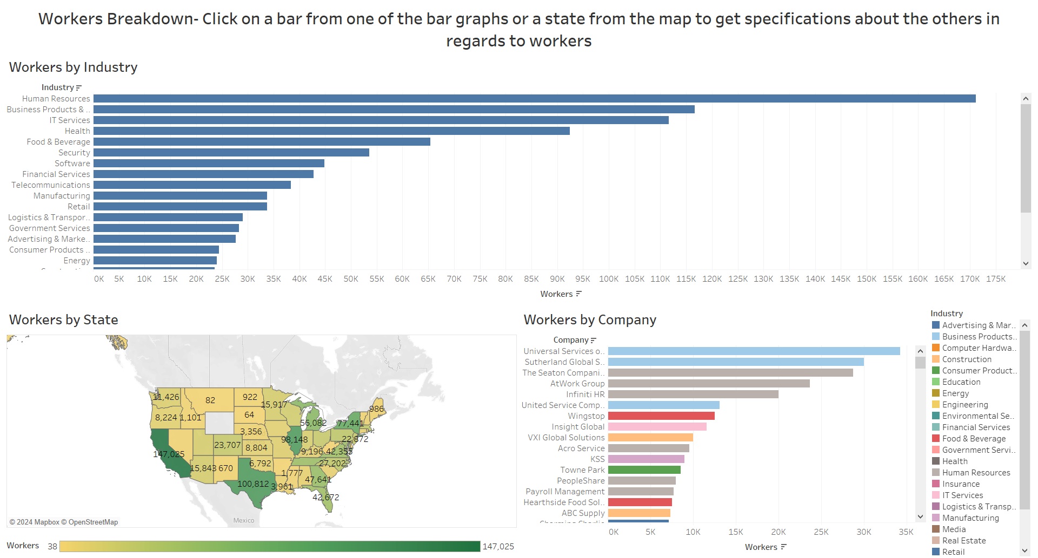
Tableau “Workers Breakdown” Dashboard Visual

Slide 36
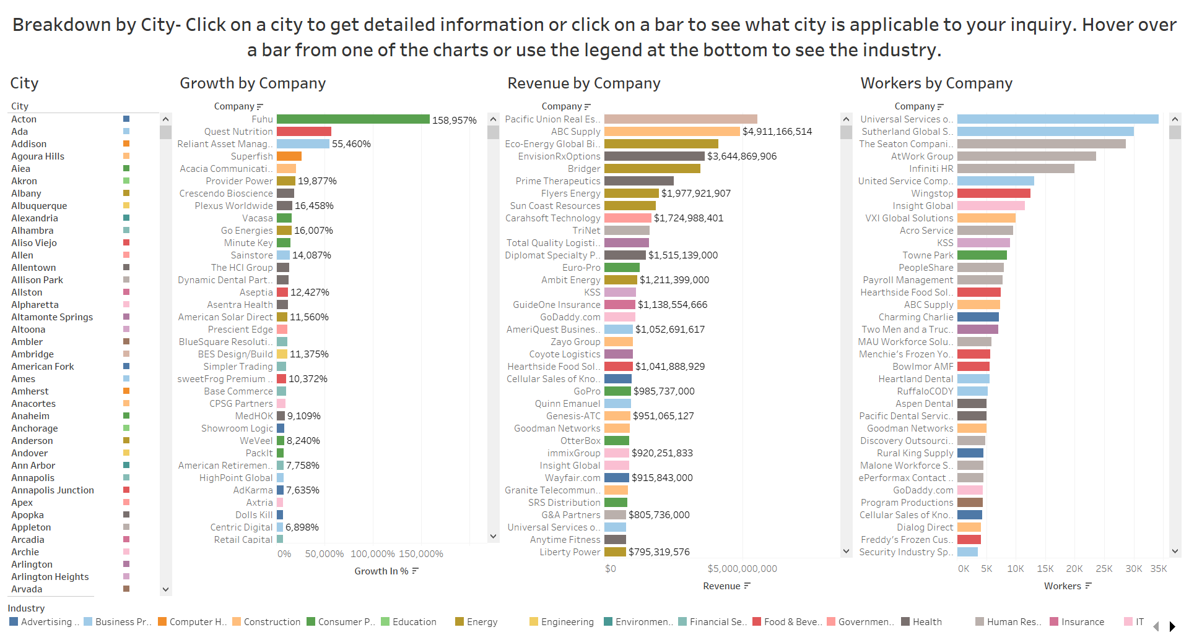
Tableau “Breakdown by City” Dashboard Visual

Slide 37
Further Analysis
Areas to Improve:
I would like to have access to all of the years that Inc. Magazine has put out this list so that I can analyze the data over time to develop new insights.
I would also like to have access to each companies' yearly revenue in terms of relevance to the growth percentage period so I can gain more accurate insights from one year to the next for each company’s revenue.
Possible Solution: Contact Inc.com and request all of the Inc.5000 datasets. Also request that they provide the year-to-year revenue for each company.
Future Research: What are the top 5000 fastest-growing public companies?

Slide 38
References
https://public.tableau.com/app/resources/sample-data (Dataset)
https://www.inc.com/about/index.html (Who is Inc. Magazine/Inc.Com?)
https://incmagazine.zendesk.com/hc/en-us/articles/360000101526-What-is-the-Inc-5000- (What is the Inc.5000?)
https://incmagazine.zendesk.com/hc/en-us/articles/360000098983-How-are-companies-ranked-on-the-2023-Inc-5000-list- (How growth percentage is calculated)
https://www.inc.com/jill-krasny/inc5000/2014/facts-and-figures-percentage.html (An article showing revenue being based in the year 2013)
https://www.linkedin.com/company/fuhu-inc (Fuhu)

